Slide 1


Principles of Information Security,
Fifth Edition
Chapter 10
Implementing Information Security

Slide 2
Learning Objectives
Upon completion of this material, you should be able to:
  Explain how an organization’s information security blueprint becomes a project plan
  Discuss the many organizational considerations that a project plan must address
  Explain the significance of the project manager’s role in the success of an information security project
  Describe the need for professional project management for complex projects
Principles of Information Security, Fifth Edition
Notes:
Learning Objectives
Upon completion of this material, you should be able to:
Explain how an organization’s information security blueprint becomes a project plan
Discuss the many organizational considerations that a project plan must address
Explain the significance of the project manager’s role in the success of an information security project
Describe the need for professional project management for complex projects

Slide 3
Learning Objectives (cont’d)
  Describe technical strategies and models for implementing a project plan
  List and discuss the nontechnical problems that organizations face in times of rapid change
Principles of Information Security, Fifth Edition
Notes:
Learning Objectives
Describe technical strategies and models for implementing a project plan
List and discuss the nontechnical problems that organizations face in times of rapid change

Slide 4
Introduction
SecSDLC implementation phase is accomplished by changing the configuration and operation of an organization’s information systems.
Implementation includes changes to:
  Procedures (through policy)
  People (through training)
  Hardware (through firewalls)
  Software (through encryption)
  Data (through classification)
Organization translates blueprint for information security into a project plan.
Principles of Information Security, Fifth Edition
Notes:
Introduction
SecSDLC implementation phase is accomplished by changing the configuration and operation of organization’s information systems
Implementation includes changes to:
Procedures (through policy)
People (through training)
Hardware (through firewalls)
Software (through encryption)
Data (through classification)
Organization translates blueprint for information security into a project plan

Slide 5
Information Security Project Management
Project plan must address project leadership, managerial/technical/budgetary considerations, and organizational resistance to change.
Major steps in executing a project plan are:
  Planning the project
  Supervising tasks and action steps
  Wrapping up
Each organization must determine its own project management methodology for IT and information security projects.
Principles of Information Security, Fifth Edition
Notes:
Project Management in the Implementation Phase
Project plan must address project leadership, managerial/technical/budgetary considerations, and organizational resistance to change
Major steps in executing project plan are:
Planning the project
Supervising tasks and action steps
Wrapping up
Each organization must determine its own project management methodology for IT and information security projects

Slide 6
Developing the Project Plan
Creation of a project plan can be done using work breakdown structure (WBS).
Major project tasks in WBS are:
  Work to be accomplished
  Assignees
  Start and end dates
  Amount of effort required
  Estimated capital and noncapital expenses
  Identification of dependencies between/among tasks
Each major WBS task is further divided into smaller tasks or specific action steps.
Principles of Information Security, Fifth Edition
Notes:
Developing the Project Plan
Creation of project plan can be done using work breakdown structure (WBS)
Major project tasks in WBS are:
Work to be accomplished
People/skill sets assigned
Start and end dates
Amount of effort required
Estimated capital and noncapital expenses
Identification of dependencies between/among tasks
Each major WBS task is further divided into smaller tasks or specific action steps

Slide 7
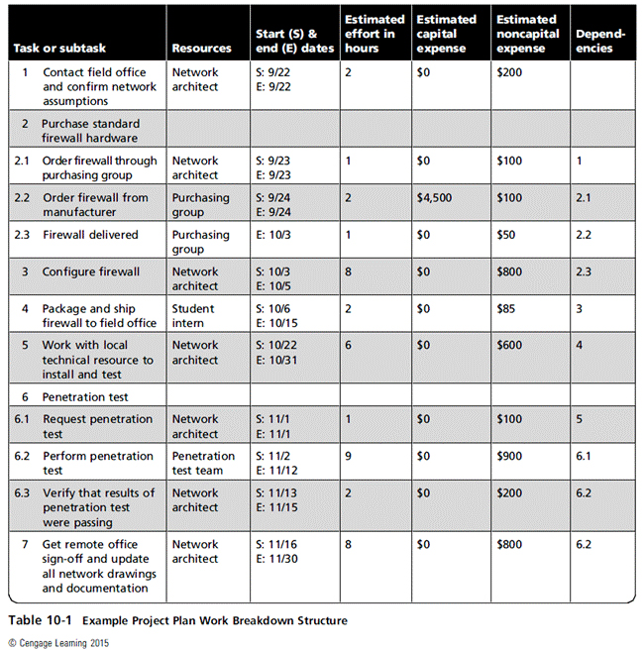
Principles of Information Security, Fifth Edition

Slide 8
Project Planning Considerations
As project plan is developed, adding detail is not always straightforward.
Special considerations include financial, priority, time and schedule, staff, procurement, organizational feasibility, training and indoctrination, and scope.
Principles of Information Security, Fifth Edition
Notes:
Project Planning Considerations
As project plan is developed, adding detail is not always straightforward
Special considerations include financial, priority, time and schedule, staff, procurement, organizational feasibility, training and indoctrination, and scope

Slide 9
Project Planning Considerations (cont’d)
Financial considerations
  Regardless of existing information security needs, the amount of effort that can be expended depends on available funds.
  Cost-benefit analysis must be reviewed and verified prior to the development of a project plan.
  Both public and private organizations have budgetary constraints, though of a different nature.
  To justify an amount budgeted for a security project at either public or for-profit organizations, it may be useful to benchmark expenses of similar organizations.
Principles of Information Security, Fifth Edition
Notes:
Financial Considerations
Regardless of existing information security needs, the amount of effort that can be expended depends on available funds
Cost benefit analysis must be reviewed and verified prior to development of project plan
Both public and private organizations have budgetary constraints, though of a different nature
To justify an amount budgeted for a security project at either public or for-profit organizations, it may be useful to benchmark expenses of similar organizations

Slide 10
Project Planning Considerations (cont’d)
Priority considerations
  In general, the most important information security controls should be scheduled first.
  Implementation of controls is guided by prioritization of threats and value of threatened information assets.
Principles of Information Security, Fifth Edition
Notes:
Priority Considerations
In general, the most important information security controls should be scheduled first
Implementation of controls is guided by prioritization of threats and value of threatened information assets

Slide 11
Project Planning Considerations (cont’d)
Time and scheduling considerations
  Time impacts project plans at dozens of points, including:
    Time to order, receive, install, and configure security control
    Time to train the users
    Time to realize control’s return on investment
Principles of Information Security, Fifth Edition
Notes:
Time and Scheduling Considerations
Time impacts project plans at dozens of points, including:
Time to order, receive, install, and configure security control
Time to train the users
Time to realize control’s return on investment

Slide 12
Project Planning Considerations (cont’d)
Staffing considerations
  Need for qualified, trained, and available personnel constrains project plan
  Experienced staff is often needed to implement technologies and develop and implement policies and training programs.
Procurement considerations
  Often constraints on the selection of equipment/services
    Some organizations require use of particular service vendors/manufacturers/suppliers.
  These constraints may limit which technologies can be acquired.
Principles of Information Security, Fifth Edition
Notes:
Staffing considerations
Need for qualified, trained, and available personnel constrains project plan
Experienced staff is often needed to implement technologies and develop and implement policies and training programs
Procurement considerations
Often constraints on selection of equipment/services
Some organizations require use of particular service vendors/manufacturers/suppliers
These constraints may limit which technologies can be acquired

Slide 13
Project Planning Considerations (cont’d)
Organizational feasibility considerations
  Changes should be transparent to system users unless the new technology is intended to change procedures (e.g., requiring additional authentication or verification).
  Successful project requires that organization be able to assimilate proposed changes.
  New technologies sometimes require new policies, employee training, and education.
Principles of Information Security, Fifth Edition
Notes:
Organizational Feasibility Considerations
Changes should be transparent to system users unless the new technology is intended to change procedures (e.g., requiring additional authentication or verification)
Successful project requires that organization be able to assimilate proposed changes
New technologies sometimes require new policies, employee training, and education

Slide 14
Project Planning Considerations (cont’d)
Training and indoctrination considerations
  Size of organization and normal conduct of business may preclude a large training program for new security procedures/technologies.
  If so, the organization should conduct phased-in or pilot implementation.
Principles of Information Security, Fifth Edition
Notes:
Training and Indoctrination Considerations
Size of organization and normal conduct of business may preclude a large training program for new security procedures/technologies
If so, organization should conduct phased-in or pilot implementation

Slide 15
Project Planning Considerations (cont’d)
Scope considerations
  Project scope: description of project’s features, capabilities, functions, and quality level, used as the basis of a project plan
  Organizations should implement large information security projects in stages.
Principles of Information Security, Fifth Edition
Notes:
Scope Considerations
Project scope: description of project’s features, capabilities, functions, and quality level, used as the basis of a project plan
Organizations should implement large information security projects in stages

Slide 16
The Need for Project Management
Project management requires a unique set of skills and thorough understanding of a broad body of specialized knowledge.
Most information security projects require a trained project manager (a CISO) or skilled IT manager trained in project management techniques.
Principles of Information Security, Fifth Edition
Notes:
The Need for Project Management
Project management requires a unique set of skills and thorough understanding of a broad body of specialized knowledge
Most information security projects require a trained project manager (a CISO) or skilled IT manager trained in project management techniques

Slide 17
The Need for Project Management (cont’d)
Supervised implementation
  Some organizations may designate a champion from general management community of interest to supervise implementation of information security project plan.
  An alternative is to designate a senior IT manager or CIO to lead implementation.
  Best solution is to designate a suitable person from information security community of interest.
  In final analysis, each organization must find project leadership best suited to its specific needs.
Principles of Information Security, Fifth Edition
Notes:
Supervised Implementation
Some organizations may designate champion from general management community of interest to supervise implementation of information security project plan
An alternative is to designate senior IT manager or CIO to lead implementation
Best solution is to designate a suitable person from information security community of interest
In final analysis, each organization must find project leadership best suited to its specific needs

Slide 18
The Need for Project Management (cont’d)
Executing the plan
  A negative feedback loop ensures that project progress is measured periodically.
    When significant deviation occurs, corrective action is taken.
  Often, a project manager can adjust one of three planning parameters for the task being corrected:
    Effort and money allocated
    Elapsed time/Scheduling impact
    Quality or quantity of deliverable
Principles of Information Security, Fifth Edition
Notes:
Executing the Plan
Negative feedback loop ensures project progress is measured periodically
When significant deviation occurs, corrective action taken
Often, project manager can adjust one of three planning parameters for task being corrected:
Effort and money allocated
Elapsed time/Scheduling impact
Quality or quantity of deliverable

Slide 19
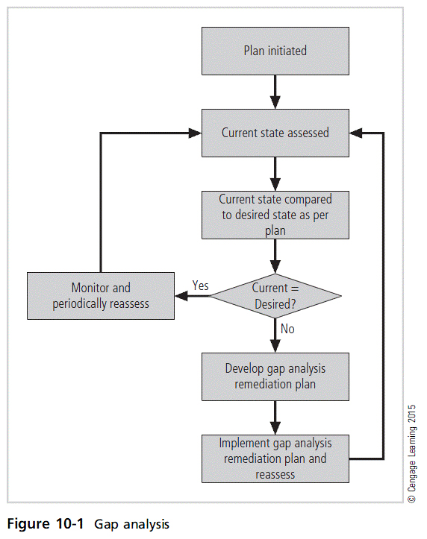
Principles of Information Security, Fifth Edition

Slide 20
The Need for Project Management (cont’d)
Project wrap-up
  Project wrap-up is usually handled as procedural task and assigned to mid-level IT or information security manager.
  Collect documentation, finalize status reports, and deliver final report and presentation at wrap-up meeting
  Goal of wrap-up is to resolve any pending issues, critique overall project effort, and draw conclusions about how to improve process.
Principles of Information Security, Fifth Edition
Notes:
Project Wrap-up
Project wrap-up is usually handled as procedural task and assigned to mid-level IT or information security manager
Collect documentation, finalize status reports, and deliver final report and presentation at wrap-up meeting
Goal of wrap-up is to resolve any pending issues, critique overall project effort, and draw conclusions about how to improve process

Slide 21
Security Project Management Certifications
GIAC certified project manager
  Offered by SANS Institute; focuses on security professionals/managers with project management responsibilities
IT security project management
  Offered by EC Council as a milestone in its Certified E-Business Professional program
Certified security project manager
  Security Industry Association focused on physical security; also incorporates information security
Principles of Information Security, Fifth Edition
Notes:
Security Project Management Certifications
GIAC certified project manager
Offered by SANS Institute; focuses on security professionals/managers with project management responsibilities
IT security project management
Offered by EC Council as a milestone in its Certified E-Business Professional program
Certified security project manager
Security Industry Association focused on physical security; also incorporates information security

Slide 22
Technical Aspects of Implementation
Some aspects of implementation process are technical and deal with the application of technology.
  Others deal with human interface to technical systems.
Principles of Information Security, Fifth Edition
Notes:
Technical Topics of Implementation
Some parts of the implementation process are technical in nature, dealing with the application of technology, while others are not, dealing instead with the human interface to technical systems.

Slide 23
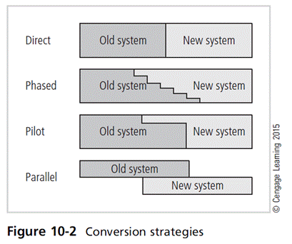
Conversion Strategies
As components of new security system are planned, provisions must be made for changeover from the previous method of performing a task to the new method.
Four basic approaches:
  Direct changeover
  Phased implementation
  Pilot implementation
  Parallel operations
Principles of Information Security, Fifth Edition
Notes:
Conversion Strategies
As components of new security system are planned, provisions must be made for changeover from previous method of performing task to new method
Four basic approaches:
Direct changeover
Phased implementation
Pilot implementation
Parallel operations

Slide 24
The Bull’s-Eye Model
Proven method for prioritizing program of complex change
Requires that issues be addressed from general to specific; focus is on systematic solutions and not on individual problems
Relies on the process of project plan evaluation in four layers:
  Policies
  Networks
  Systems
  Applications
Principles of Information Security, Fifth Edition
Notes:
The Bull’s-Eye Model
Proven method for prioritizing program of complex change
Requires that issues be addressed from general to specific; focus is on systematic solutions and not individual problems
Relies on process of project plan evaluation infour layers:
Policies
Networks
Systems
Applications

Slide 25
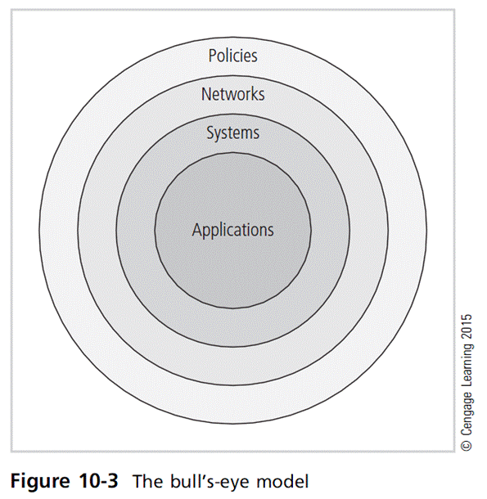
Principles of Information Security, Fifth Edition

Slide 26
To Outsource or Not
Just as some organizations outsource IT operations, organizations can outsource part or all of their information security programs.
When an organization outsources most/all IT services, information security should be part of contract arrangement with the supplier.
Organizations of all sizes frequently outsource network monitoring functions.
Principles of Information Security, Fifth Edition
Notes:
To Outsource or Not
Just as some organizations outsource IT operations, organizations can outsource part or all of information security programs
When organization outsources most/all IT services, information security should be part of contract arrangement with supplier
Organizations of all sizes frequently outsource network monitoring functions

Slide 27
Technology Governance and Change Control
Technology governance guides how frequently technical systems are updated and how updates are approved/funded.
By managing the process of change, the organization can:
  Improve communication, enhance coordination, reduce unintended consequences, improve quality of service, and ensure groups are complying with policies
Principles of Information Security, Fifth Edition
Notes:
Technology Governance and Change Control
Other factors that determine the success of an organization’s IT and information security are technology governance and change control processes.
Technology governance is a complex process that an organization uses to manage the impacts and costs caused by technology implementation, innovation, and obsolescence.
Technology governance also facilitates the communication about technical advances and issues across the organization.
Medium or large organizations deal with the impact of technical change on the operation of the organization through a change control process.
By managing the process of change, the organization can:
Improve communication about change
Enhance coordination between organizational groups as change is scheduled and completed
Reduce unintended consequences by having a process to resolve potential conflict and disruption
Improve quality of service as potential failures are eliminated and groups work together
Assure management that all groups are complying with the organization’s policies regarding technology governance, procurement, accounting, and information security

Slide 28
Nontechnical Aspects of Implementation
Some aspects of implementation are not technical in nature, instead dealing with the human interface to technical systems.
Include creating a culture of change management and considerations for the organizations facing change.
Principles of Information Security, Fifth Edition
Notes:
Nontechnical Topics of Implementation
Some aspects of implementation are not technical in nature, instead dealing with the human interface to technical systems
Include creating a culture of change management and considerations for organizations facing change

Slide 29
The Culture of Change Management
Prospect of change can cause employees to consciously or unconsciously resist the change.
The stress of change can increase the probability of mistakes or create vulnerabilities in systems.
Change management can lower resistance to change and build resilience.
Lewin change model:
  Unfreezing
  Moving
  Refreezing
Principles of Information Security, Fifth Edition
Notes:
The Culture of Change Management
Prospect of change can cause employees to consciously or unconsciously resist the change
The stress of change can increase the probability of mistakes or create vulnerabilities in systems
Change management can lower resistance to change and build resilience
Lewin change model:
Unfreezing
Moving
Refreezing

Slide 30
Considerations for Organizational Change
Steps can be taken to make employees more amenable to change:
  Reducing resistance to change from the start
  Developing a culture that supports change
Principles of Information Security, Fifth Edition
Notes:
Considerations for Organizational Change
In order to make an organization more amenable to change, some steps can be taken.
This includes reducing resistance to change from the beginning of the planning process and steps taken to modify the organization to be more accepting of change.

Slide 31
Considerations for Organizational Change (cont’d)
Reducing resistance to change from the start
  The more ingrained the existing methods and behaviors, the more difficult the change.
  Best to improve interaction between affected members of organization and project planners in early project phases
  Three-step process for project managers: communicate, educate, and involve
  Joint application development
Principles of Information Security, Fifth Edition
Notes:
Reducing Resistance to Change from the Start
The more ingrained the existing methods and behaviors, the more difficult the change
Best to improve interaction between affected members of organization and project planners in early project phases
Three-step process for project managers: communicate, educate, and involve
Joint application development

Slide 32
Considerations for Organizational Change (cont’d)
Developing a culture that supports change
  Ideal organization fosters resilience to change
  Resilience: An organization understands change is a necessary part of the organizational culture, and embracing change is more productive than fighting it.
  To develop such a culture, the organization must successfully accomplish many projects that require change.
Principles of Information Security, Fifth Edition
Notes:
Developing a culture that supports change
Ideal organization fosters resilience to change
Resilience: organization understands change is a necessary part of organizational culture, and embracing change is more productive than fighting it
To develop such a culture, organization must successfully accomplish many projects that require change

Slide 33
Information Systems Security Certification and Accreditation
It may seem that only systems handling secret government data require security certification and accreditation.
In order to comply with recent federal regulations protecting personal privacy, the organizations need to have formal mechanisms for verification and validation.
Principles of Information Security, Fifth Edition
Notes:
Information Systems Security Certification and Accreditation
It may seem that only systems handling secret government data require security certification and accreditation
In order to comply with recent federal regulations protecting personal privacy, organizations need to have formal mechanisms for verification and validation

Slide 34
Information Systems Security Certification and Accreditation (cont’d)
Certification versus accreditation
  Accreditation: authorizes IT system to process, store, or transmit information; assures systems of adequate quality
  Certification: evaluation of technical and nontechnical security controls of IT system establishing extent to which design and implementation meet security requirements
Principles of Information Security, Fifth Edition
Notes:
Certification versus accreditation
Accreditation: authorizes IT system to process, store, or transmit information; assures systems of adequate quality
Certification: evaluation of technical and nontechnical security controls of IT system establishing extent to which design and implementation meet security requirements

Slide 35
The NIST Security Life Cycle Approach
SP 800-37, Rev. 1: Guidelines for Applying the Risk Management Framework to Federal Information Systems, and CNSS Instruction-1000: National Information Assurance Certification and Accreditation Process (NIACAP)
  Provide guidance for the certification and accreditation of federal information systems
Information processed by the federal government is grouped into one of three categories:
  National security information (NSI)
  Non-NSI
  Intelligence community (IC)
Principles of Information Security, Fifth Edition
Notes:
The NIST Security Life Cycle Approach
SP 800-37, Rev. 1: Guidelines for Applying the Risk Management Framework to Federal Information Systems; and CNSS Instruction-1000: National Information Assurance Certification and Accreditation Process (NIACAP)
Provide guidance for the certification and accreditation of federal information systems
Information processed by the federal government is grouped into one of three categories:
National security information (NSI)
Non-NSI
Intelligence community (IC)

Slide 36
The NIST Security Life Cycle Approach (cont’d)
A new publication, NIST SP 800-39: Integrated Enterprise-Wide Risk Management: Organization, Mission, and Information Systems View builds on a three-tiered approach to risk management
  Tier 1 addresses risk from organizational perspective
  Tier 2 addresses risk from mission/business process perspective
  Tier 3 addresses risk from information system perspective
Principles of Information Security, Fifth Edition
Notes:
NIST Security Life Cycle Approach
A new publication, NIST SP 800-39: Integrated Enterprise-Wide Risk Management: Organization, Mission, and Information Systems View builds on a three-tiered approach to risk management
Tier 1 addresses risk from organizational perspective
Tier 2 addresses risk from mission/business process perspective
Tier 3 addresses risk from information system perspective

Slide 37
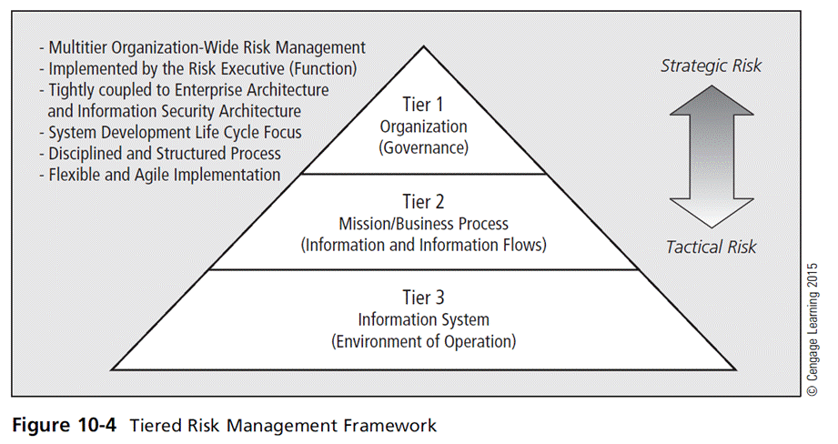
Principles of Information Security, Fifth Edition

Slide 38
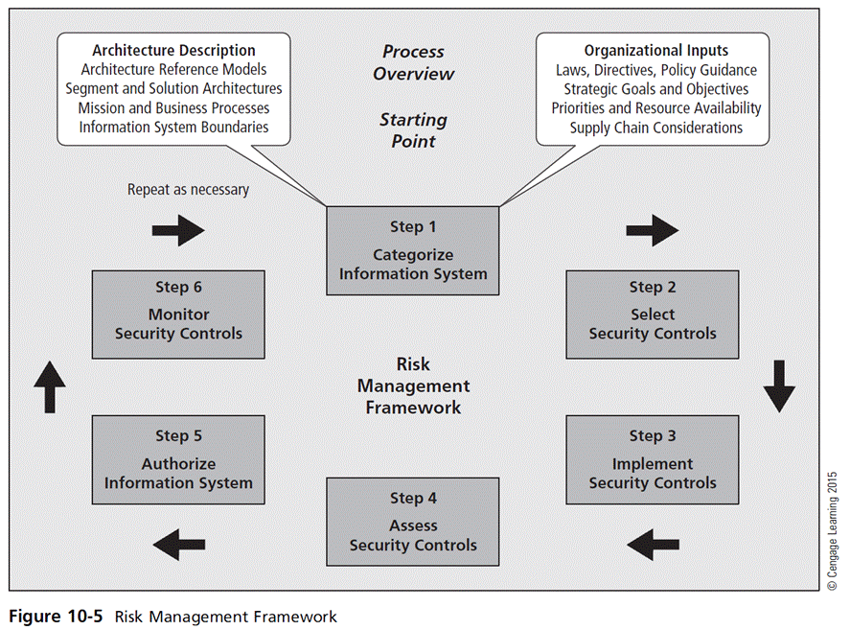
Principles of Information Security, Fifth Edition

Slide 39
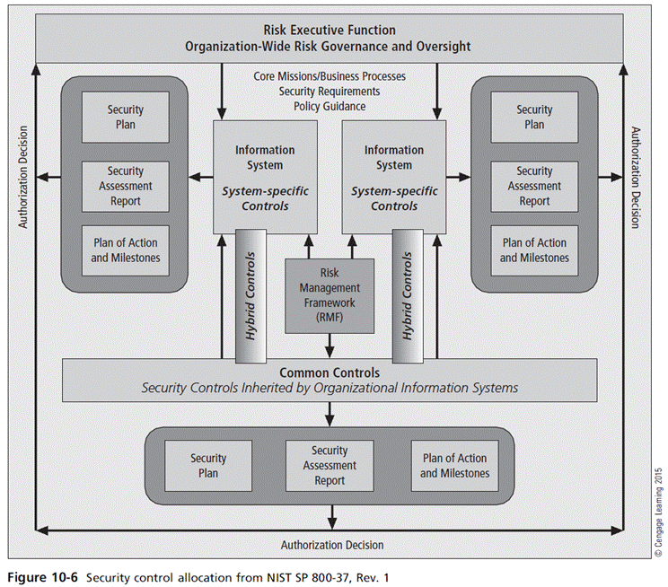
Principles of Information Security, Fifth Edition

Slide 40
NSTISS Certification and Accreditation
National security interest systems have their own C&A standards
NSTISS Instruction 1000: National Information Assurance Certification and Accreditation Process (NIACAP)
  Establishes minimum national standards for certifying/accrediting national security systems
  Designed to certify that IS meets documented requirements
  Composed of four phases: definition, verification, validation, and post accreditation
Principles of Information Security, Fifth Edition
Notes:
NSTISS Certification and Accreditation
National security interest systems have their own C&A standards
NSTISS Instruction 1000: National Information Assurance Certification and Accreditation Process (NIACAP)
Establishes minimum national standards for certifying/accrediting national security systems
Designed to certify that IS meets documented requirements
Composed of four phases: Definition, Verification, Validation, and Post Accreditation

Slide 41
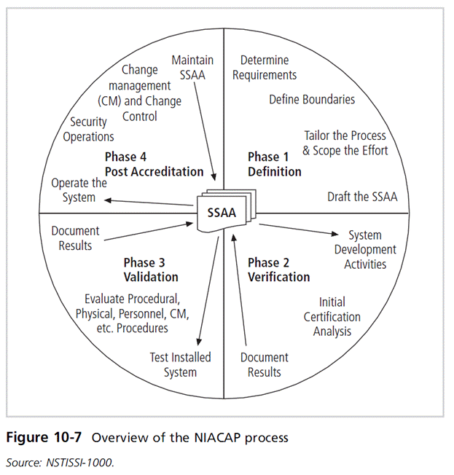
Principles of Information Security, Fifth Edition

Slide 42
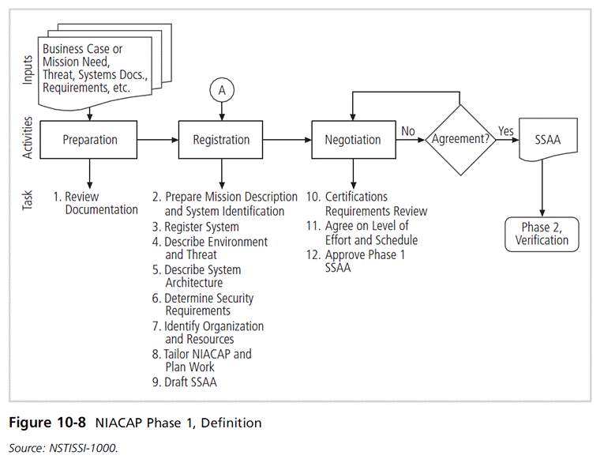
Principles of Information Security, Fifth Edition

Slide 43
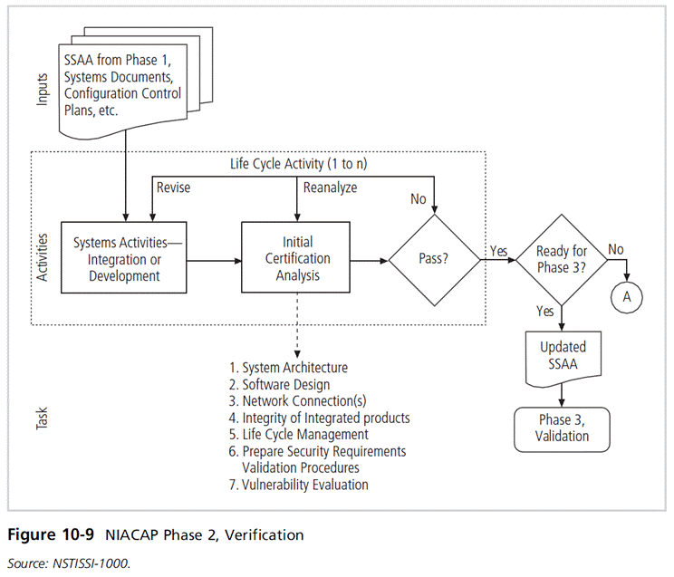
Principles of Information Security, Fifth Edition

Slide 44
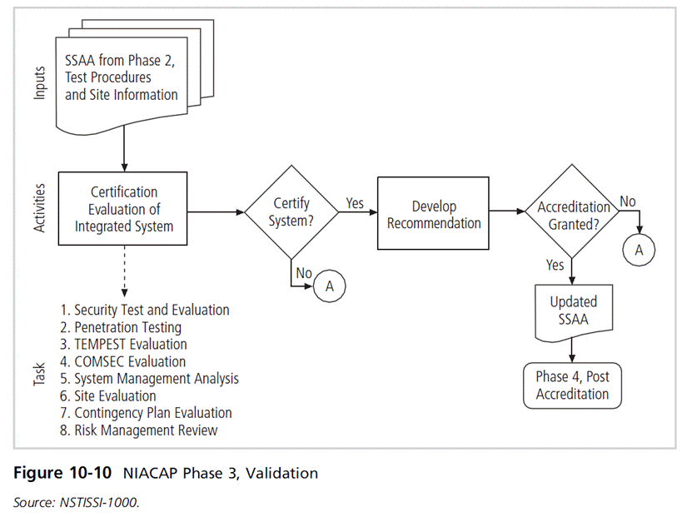
Principles of Information Security, Fifth Edition

Slide 45
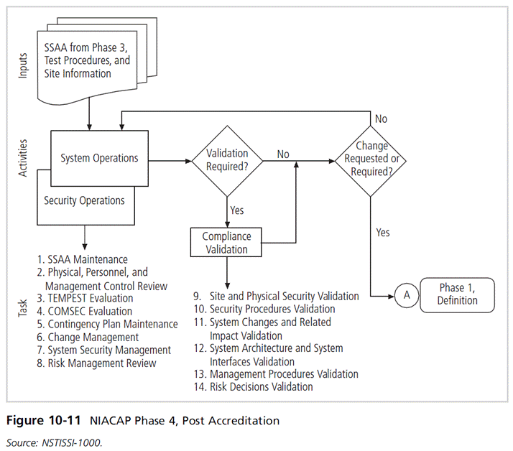
Principles of Information Security, Fifth Edition

Slide 46
ISO 27001/ 27002 Systems Certification and Accreditation
Organizations outside the United States apply these standards.
Standards were originally created to provide a foundation for British certification of information security management systems (ISMSs).
Organizations wishing to demonstrate their systems have met this international standard must follow the certification process.
Principles of Information Security, Fifth Edition
Notes:
ISO 27001/27002 Systems Certification and Accreditation
Organizations outside the United States apply the standards provided under these standards
Standards were originally created to provide a foundation for British certification of information security management systems (ISMSs)
Organizations wishing to demonstrate their systems have met this international standard must follow the certification process

Slide 47
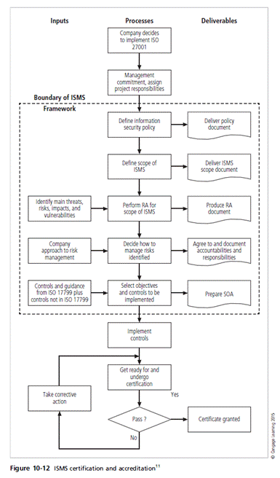
Principles of Information Security, Fifth Edition

Slide 48
Summary
Moving from security blueprint to project plan
Organizational considerations addressed by project plan
Project manager’s role in the success of an information security project
Technical strategies and models for implementing project plan
Nontechnical problems that organizations face in times of rapid change
Principles of Information Security, Fifth Edition

